Slide 1
GEOG0125
Advanced Topics in Social and Geographic Data Science
Research methods, study design & REVISION
Dr Anwar Musah (a.musah@ucl.ac.uk)
Lecturer in Social and Geographic Data Science
UCL Geography
1

Slide 2
Contents
Problem
What is the meaning of Research Design
Types of Research Design
Quantitative
Qualitative
Types of Quantitative Study Methods
Descriptive studies
Observational studies
Randomized Control Trials
Study Designs
Biases with focus on ecological designs
Ecological fallacies
Modifiable Areal Unit Problem (MAUP)
Residual confounding (with regression models)
Misclassification bias (with ML image classification)
Best practices
Summary of GEOG0125
Knowledge
Collect
Model
Wrangle
Explore
2

Slide 3
What is a Research Design?
3

Slide 4
Definition:
Research Design typically refers to the investigator’s strategy or plan for tackling a research question through collection of data, analysis and interpretation of such data, and finally a thorough discussion of that said data. In other words, or to simply put: “… it’s someone’s blueprint for answering a research question”
Types of Research Design:
Qualitative: This area allows the investigator to gain meaningful insight (or empirical evidence) of certain phenomena through the study of non-numerical pieces of information
Quantitative: This area allows the researcher to derive meaningful insight (or empirical evidence) about certain phenomena through analysis of numerical information by use of a study design.
Descriptive studies
Observational studies
Experimental studies
For quantitative research, the purpose is to establish AT LEAST one of three things: 1.) Evidence of causality (or an association); 2.) Internal validity; and/or 3.) External validity.
4
Notes:
… for the purpose of establishing these three things - Evidence of causality (or an association); Internal validity and External validity

Slide 5
Types of Study Design
Type | Study Design | Properties
Descriptive | Ecological (or geographic)*** Cross-sectional | Identify certain characteristics Initial steps for searching the risk factors Generating further hypothesis
Observational | Case-control Cohort (or longitudinal) | Observe the effect of a risk factor(s)
Experimental | Randomised control trials (RCT)* | Observe the effect of diagnostic test, or other intervention in a group
Pilot study is a special cases as it could be anyone of these study designs
5

Slide 6
Ecological study
Ecological study design is a type descriptive study, where the population under investigation are analysed as groups, or aggregated units, rather than at an individual units. Aggregated units of data may include levels at a street-, postcode-, regional or even country-level
Key characteristics:
An ecological study can be integrated within a cross-sectional or longitudinal framework
There is a geographical component, which opens doors for spatial analysis and mapping
Its descriptive analysis can be used to generate more hypothesis about the study population
6

Slide 7
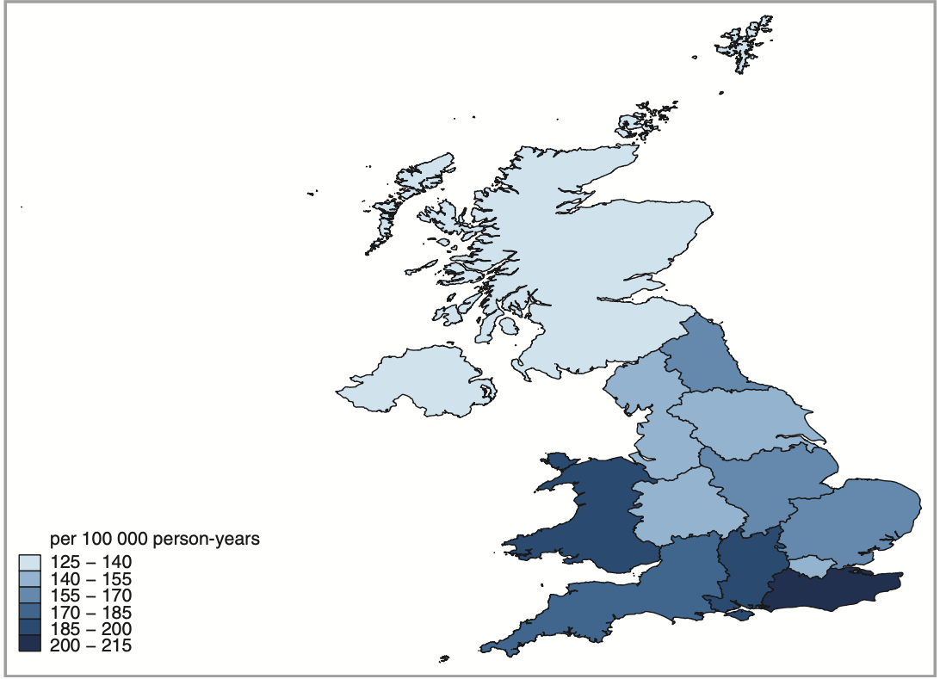
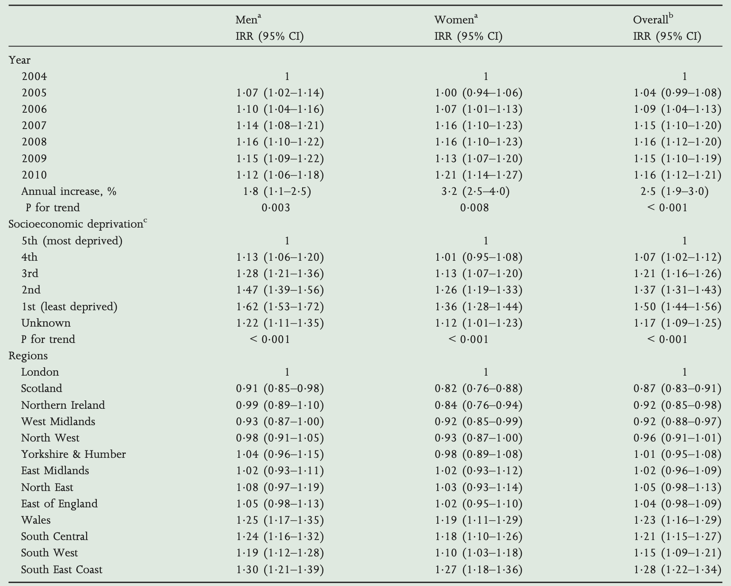
Ecological study: Regional variation in skin cancer incidence in the UK
Musah et al., 2013
Figure 1: Shows incidence age-sex standardised rates of skin cancer across SHA in the United Kingdom. The table on left panel show year-on-year, regional, and areal-levels of deprivation in association with skin cancer

Slide 8
Cross-sectional study
Cross-sectional survey is a type of descriptive study that analyses data from a population at a specific point of time. Alternatively called ‘transverse’ or ‘prevalence’ study.
Key characteristics:
Use of routinely collected data to perform large study
It is the cheapest option among other study designs
Questions can be asked to collect information retrospectively at a specific time point
Can be an analysis of individual units or aggregated units
8

Slide 9
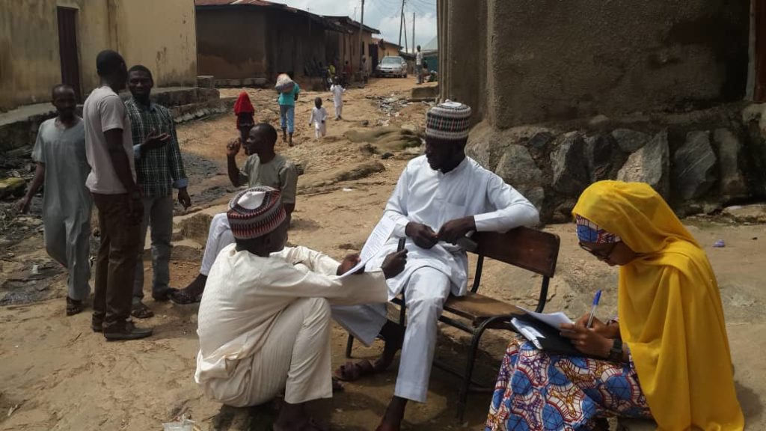
Development Frontiers in Crime, Livelihoods and Urban Poverty in Nigeria (FCLP) [1]
See source(s):
Musah et al, 2020
Umar et al, 2020
Umar et al, 2017
Themes:
Criminology
Social Science
Qualitative Research
Quantitative Research
Global South
Conventional analyses of crime, based on European research models, are often poorly suited to assessing the specific dimensions of criminality in Africa. Development Frontiers in Crime, Livelihoods and Urban Poverty in Nigeria (FCLP) aims to provide an alternative framework for understanding the specific drivers of criminality in a West African urban context.
Employing a mixed-methods approach combining statistical modelling, geo-visualisation and ethnography, the project situates insecurity and crime against a broader backdrop of rapid urban growth, seasonal migration, youth unemployment and informality. The study provides researchers both in Nigeria and internationally with a richer and more nuanced evidence base on the particular dynamics of crime in African cities.
9
Notes:
This mixed-methods research aims to bring together key development concerns related to sustainable livelihoods, social vulnerability, and poverty to build an alternative account of 'insecurity and crime' in African cities where the lines between legality and illegality, formality and informality, licit and illicit work, are often blurred in practice. We argue that the study of insecurity and crime in African cities requires a more nuanced understanding of African urbanisation patterns and historical legacies of uneven development. Situated at the nexus of population modelling, criminology, African studies, and urban geography, this project aims to challenge prevailing Euro-centric narratives of crime and victimisation through an innovative mixed-methods study. Combining statistical modelling, geovisualisation and ethnographic insights, the research aims to develop location appropriate approaches to investigate perceptions and seasonal trends of crime and victimisations in a West African city, situating the research within the broader context of African urbanisation, environment-induced seasonal migration, youth un-employment and informal economies.

Slide 10
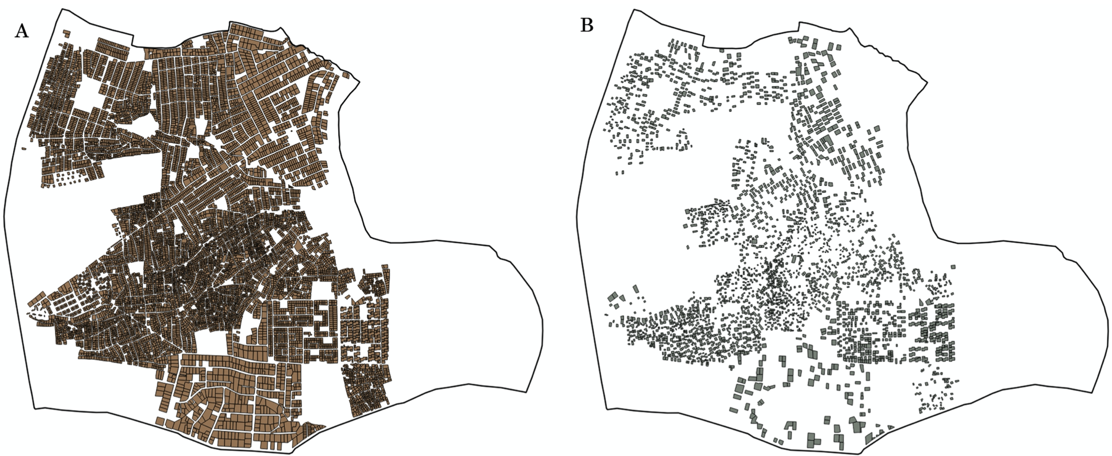
Development Frontiers in Crime, Livelihoods and Urban Poverty in Nigeria (FCLP) [2]
See source(s):
Musah et al, 2020
Umar et al, 2020
Umar et al, 2017
Themes:
Criminology
Social Science
Qualitative Research
Quantitative Research
Global South
Data collected:
Block Inventory Survey for the collection of environmental data
Household victimisation survey on indicators for crime
Perception of risk and neighbourhood safety
Demographic survey
Survey CTO Collect (open source – need a server set-up)
Primary data and sampling strategy: 13,000 households, and the target sample was 2,300 for the victimisation survey (in Nigeria); we therefore used Systematic sampling to select at random 2,300 households [the applied criteria: k = 13,000/2,300 = 5.6 ~ 6th property (starting from the left-side of road)]. Survey CTO application was used in the data collection of victimisation data.
Houses mapped in B, we had to interview all those residents (i.e., 2300 households) to collect a range of information.
10

Slide 11
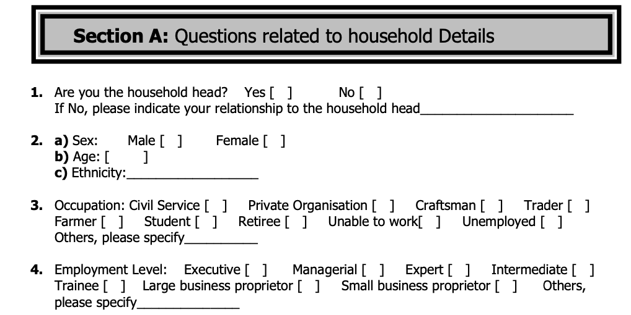
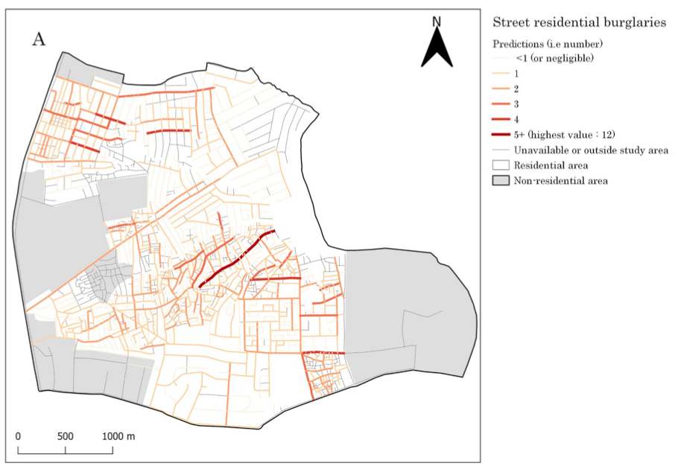
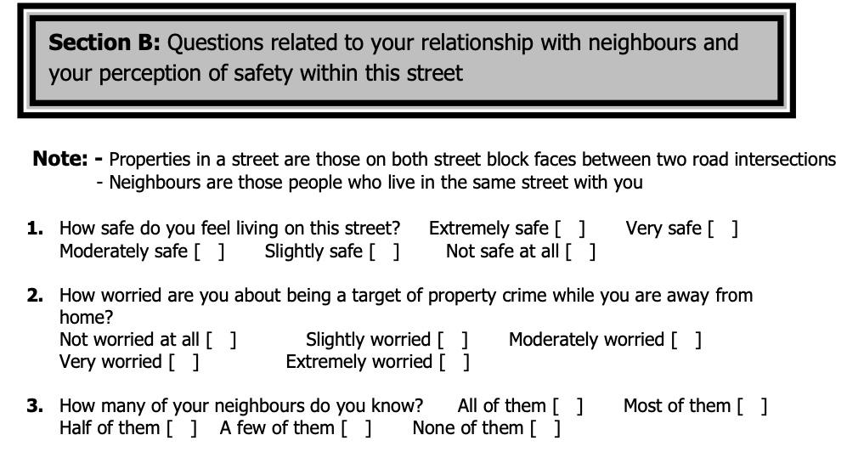
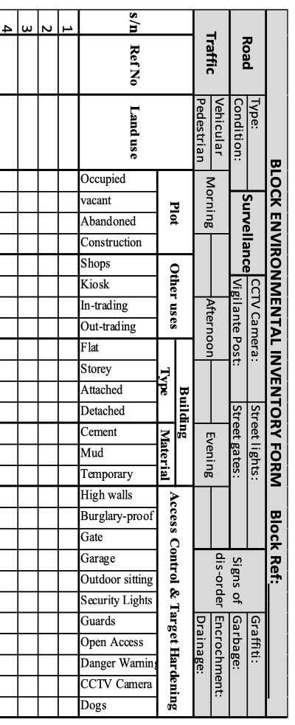
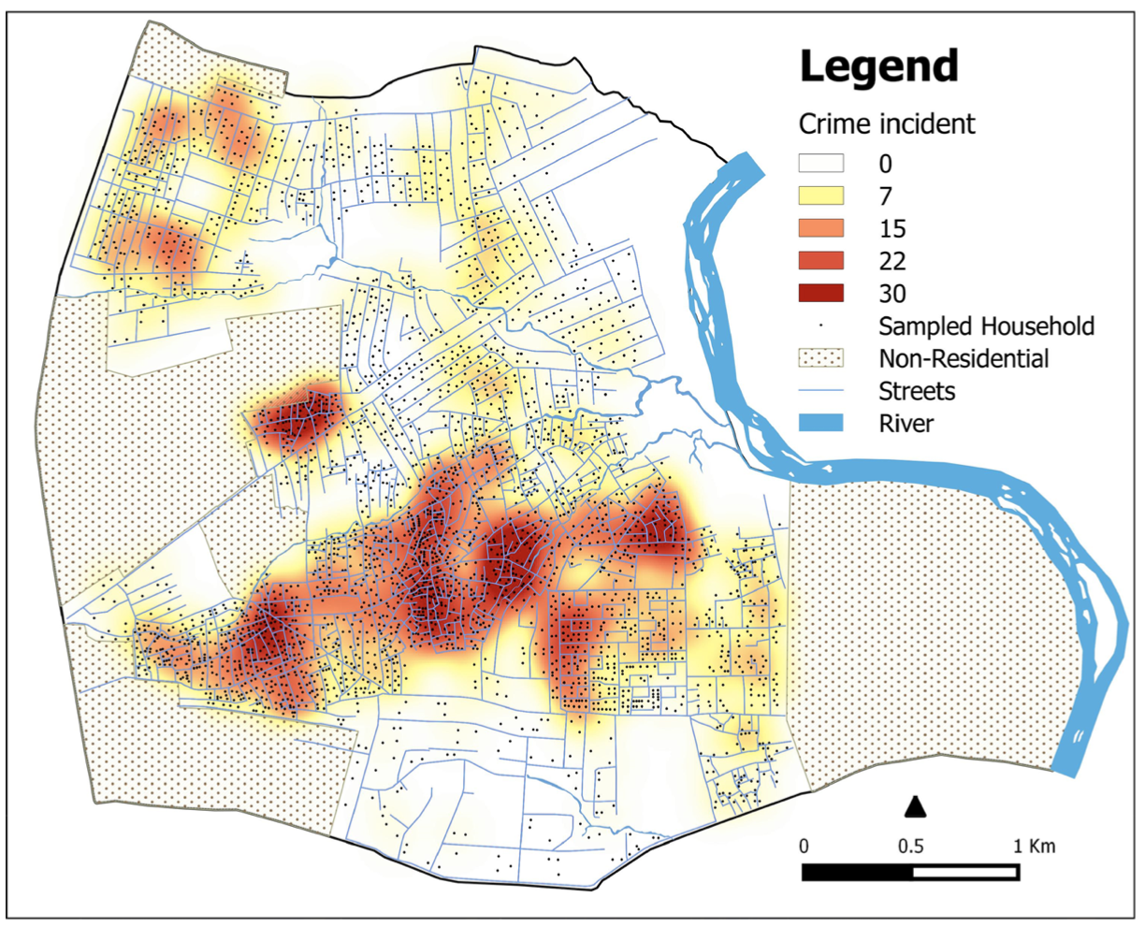
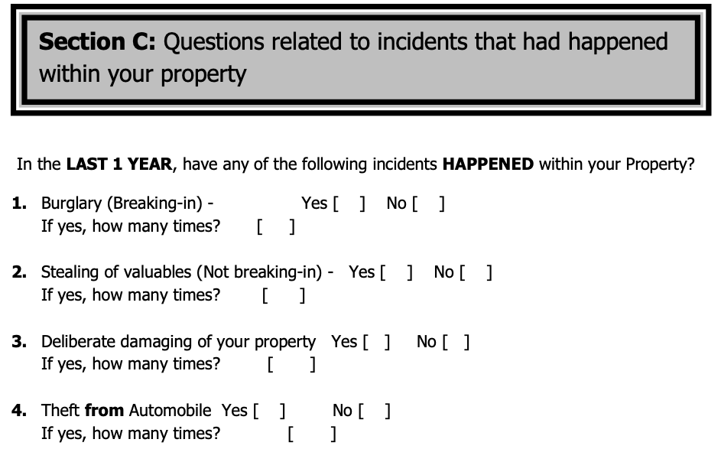


Sociodemographic variables
Physical characteristics variables
$$+$$
Perception and safety variables
Research 1: From the 2,300 household sample, we used the “crime pattern theory” to assess the risk of burglaries & victimisation at a street-level (see source: [LINK])
$$+$$
$$+$$
Victimisation (dependent) variables
Research 2: From the 2,300 households were sampled, we used the “laws of crime concentration” to assess the concentration of reported victimisation in this city (see source: [LINK])
11

Slide 12

Case-control study
Case-control study is an observational study which has two groups under analysis – a set of cases (with outcome), and a set of controls (with outcome that’s absent). The two groups are compared ‘retrospectively’ on the basis on a common exposure/independent variable.
Key characteristics:
It always deals with individual-level or units of data
The outcome is measured exclusively as a binary variable (“yes”, “no”), (“win”, “lose”), (“alive”, “dead) etc. Thus, this limits the selection of models to a simple logistic or conditional logistic regression
Cases are most often matched to a control based on similar characteristics (same age group, gender and postcode). The matching can be done 1:1, 1:2 or 1:5 etc.
It is also referred to as ‘retrospective’ study, as odds of outcome are predicted based on exposures determined retrospectively
Outcome
Case
Control
Researcher
12

Slide 13
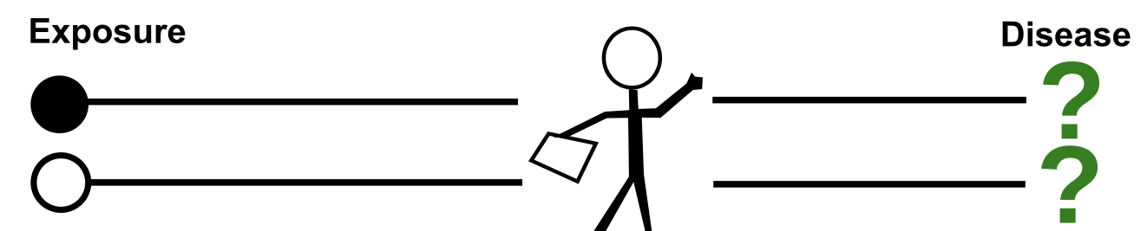
Cohort study
Cohort study is a type of observational study which focuses on the following the study participants prospectively at different points in time – answer the question about ‘change’ (e.g. pre and post, time series).
Key characteristics:
This type of study design allows to tracking the trajectory or changes in one’s exposure (or risk factor) status over his/her life course
You can literally observe the onset of an outcome
There is that time-dependencies that is taken into consideration when tracking a participant over the course of the study
Due to the time-dependent nature of study design – again, investigators must think carefully about the selection of statistical methods (i.e., survival analysis or time series are best for this).
This is referred to as ‘Prospective’ or ‘Longitudinal’ study
Outcome
Has been exposed…
Has not been exposed…
Researcher
13

Slide 14
Pilot Study
A Pilot study is the most unique type of study design which is versatile, its basically a small scale preliminary study. It is useful to test your questions on a small pilot responders, and correct the issues before launching it with the full sample
Key characteristics:
Highly flexible i.e., a pilot can be within a quantitative or qualitative framework
Highly flexible i.e., pilot can be performed with a cross-sectional or longitudinal framework
It is the most cost-effective and never time-consuming to evaluate feasibility
It is the best way to generate a hypothesis about a small population before going big
14

Slide 15
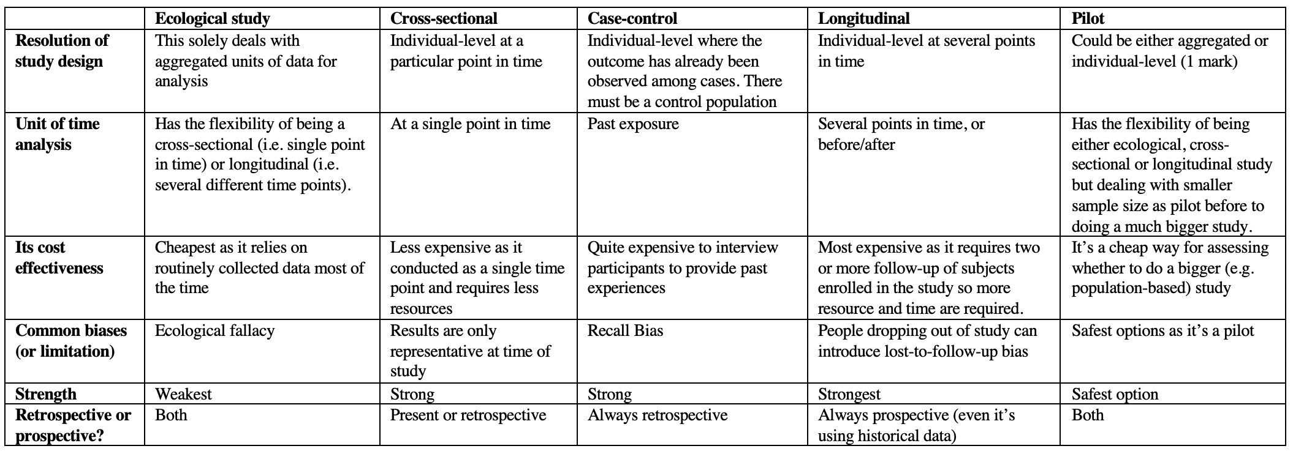
Cross comparison of quantitative-based study designs
15

Slide 16
Biases (within an Ecological Study context)
16

Slide 17
Ecological Fallacy
Ecological study design always carries this bias baggage known as Ecological Fallacy, a bias which must always be acknowledged. This is logical error that occurs when statistical inference made on groups are attributed to an individual.
Important notes to keep in mind:
Ecological studies assume what is true for a population is also true for the individual members of that population which is false.
Think of inferences made here are a gross generalization or stereotyping
To remove this type of bias completely from one’s research – it is best to perform research by using individual units of data instead of aggregated data.
Because of this bias – ecological studies are weakest!
17

Slide 18
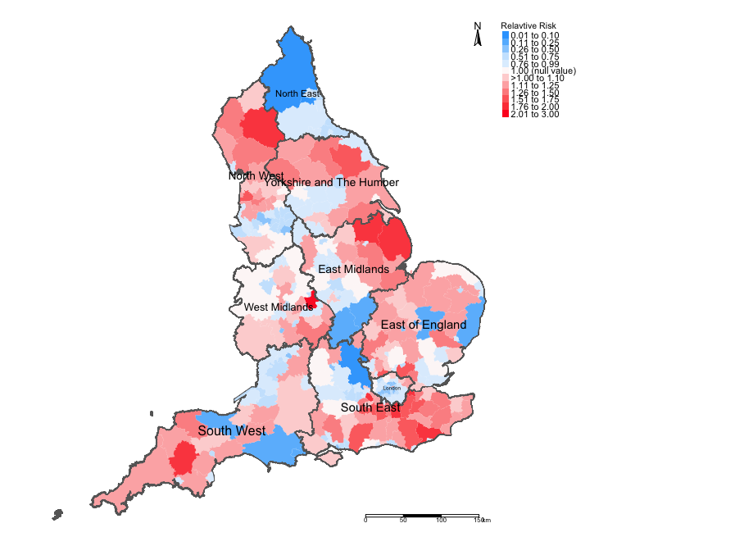
Example: Risks of Road-related casualties in England 2015-2020
Essentially, this result is saying that everywhere in this local authority has risks that are 2/3-fold for road accidents.
Do you see the problem and bias that must be acknowledged?
Relative Risks (RR)

Slide 19
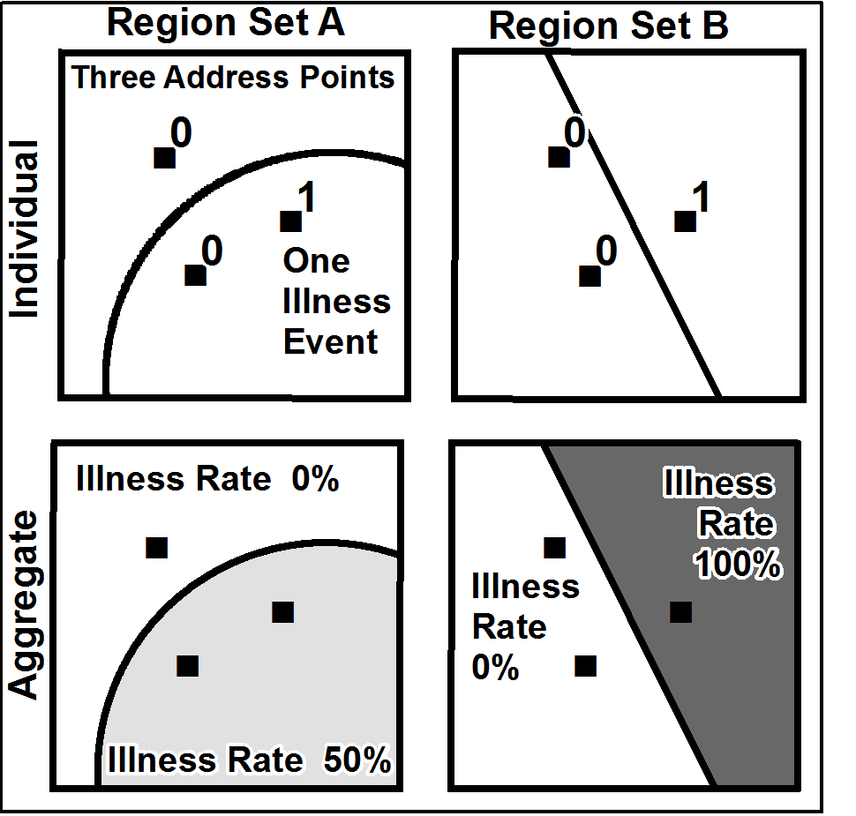
Modifiable areal unit bias (MAUB)
MAUB is a source of statistical bias in an ecological study with data on geographic units. This is concerned with how points or estimated are aggregated within areas whose boundaries change (Stan Openshaw [1984])
Important notes to keep in mind:
This is an aggregation problem (gridded, point or small areas) that arises with changing geographic boundaries.
This bias can severely distort you results.
Today, provide contemporary estimates for boundaries A. Boundaries A are modified and changes to Boundaries B. You must perform a new analysis to provides updated results as the changes in boundaries change everything!
You must acknowledge this bias whenever you have tempered with a shapefile (i.e., dissolved, clipped etc.,)
19

Slide 20
Residual Confounding (any regression analysis)
A confounding variable is a something that distorts the relationship between your primary independent variable of interest and outcome.
Important notes to keep in mind:
Confounders are central to the interpretation of any epidemiological study
Confounding factors, if not controlled for, will cause a distortion in the estimate of the impact of the independent variable(s) being study – this is important to know!
There are ‘generally’ three conditions for determining whether a variable is a confounder or not: 1.) A confounder is associated the primary independent variable of interest; 2.) but it is also a risk factor of the outcome as well; and 3.) this confounder does not exist between the causal pathway for the independent variable of interest to outcome.
Notes: In your research, you will always have an independent which is what you are primarily interested, and you want to know whether its associated to an outcome.
However, the can be other variables which must be accounted for in the analysis which can confound your association. Your lack of including other important variables in the analysis will lead to a bias known as residual confounding which you must acknowledge!
20

Slide 21
Suppose you want to perform an ecological study crimes and wanted to understand how social disorganisation as a primary independent variable was associated with burglary risk. You run a univariable spatial risk model with one single independent variable.
Socioeconomic Disorganisation
RR = 1.15
Burglary
Notes: There are ‘generally’ three conditions for determining whether a variable is a confounder or not: 1.) A confounder is associated the primary independent variable of interest; 2.) but it is also a risk factor of the outcome as well; and 3.) this confounder does not exist between the causal pathway for the independent variable of interest to outcome.
21

Slide 22
Suppose you want to perform an ecological study crimes and wanted to understand how social disorganisation as a primary independent variable was associated with burglary risk. You run a univariable spatial risk model with one single independent variable.
RR = 1.03
Burglary
Social disorganisation
Is Social deprivation a confounding variable?
1.) Its inclusion in the model caused a distortion in the RR to drop from 1.15 to 1.03
2) Social deprivation is associated with disorganisation
3) Social deprivation is also a stand alone risk factor for Burglary risk
4) It does not “technically” sit between the two variables or along the causal pathway i.e.,
Deprivation → Disorganisation → Burglary
Yes, Socioeconomic Deprivation is a confounding variable
Socioeconomic Deprivation
Notes: There are ‘generally’ three conditions for determining whether a variable is a confounder or not: 1.) A confounder is associated the primary independent variable of interest; 2.) but it is also a risk factor of the outcome as well; and 3.) this confounder does not exist between the causal pathway for the independent variable of interest to outcome.
22

Slide 23
Bias that can occur in machine learning analysis
Bias | Information
Sample (or selection) bias | Sample bias occurs when a dataset does not reflect the realities of the environment in which a model will run. An example is the development of facial recognition systems that’s solely trained on images on one particular race (e.g., only black men). These models have considerably lower levels of accuracy with women and people of different ethnicities. Another name for this bias is selection bias
Measurement bias | This type of bias occurs when the data collected for training is different from that collected in the real world (i.e., ground truth), or when faulty measurements result in data distortion.
Racial bias | Racial bias occurs when data skews in favour of particular demographics (e.g., this can be seen in facial recognition and automatic speech recognition technology which fails to recognize people of colour as accurately as it does Caucasians)
Association bias | This bias occurs when the data for a machine learning model reinforces and/or multiplies a cultural bias. Your dataset may have a collection of jobs in which all men are doctors and all women are nurses. This does not mean that women cannot be doctors, and men cannot be nurses. However, as far as your machine learning model is concerned, female doctors and male nurses do not exist. Association bias is best known for creating gender bias.
23

Slide 24
Best practices for writing a methodology
24
Notes:
For a journal or dissertation

Slide 25
Writing the methodology section [1]
Describing the where, what and when:
What: Here, you are mentioning the name of the data source and its use for a bigger study
When: The year(s) (or date(s)) at which it was collated
Where: The location of focus for which the data was collated from and the description of the study area (a map of the study area helps a lot!).
Specific details about how the data was collated:
Whether its through questionnaire survey, interview etc.,
Research framework i.e., ecological, pilot, cross-sectional, or longitudinal etc.,
Sampling strategy
Who and what the target population was i.e., target sample size and group of focus (e.g., Adults only i.e., 18 years and above etc.,)
25

Slide 26
Writing the methodology section [2]
[continue]
Describe the variables that’s going to be used for the analysis:
Codebook – provide a list of all the intended variables that is going to be analysed. You must mention specific details about variable – information such as the name, variable type (i.e., numeric or categorical) etc.,
Initial sample characteristic table – this is a breakdown on the number of observation documented for each variable (- i.e., what’s present and missing).
Example 1, suppose the total is 100 and 89 respondents provided the ages. In this table, the mean age is calculated from that 89. You must report that the mean is based on 89 point, and 11 points are missing data.
Example 2, suppose the total is 100, where 51 were women and 42 were men. You must report the numbers and percentage for each category, and report the numbers (& proportion) of missing data in the gender variable. This means including a third category: men (42), women (51), and unknown/missing (7)
26

Slide 27
ID | Name | Age | Gender | Pathway | Gamer
0001 | Brittany | 34 | Female | NA | No
0002 | Idris | NA | Male | NA | NA
0003 | Spike | 32 | Male | Political | Yes
0004 | Lara | 29 | Female | Geography | Yes
0005 | Fiona | 28 | Female | Health | No
0006 | Xiaoyu | 29 | Female | Geography | NA
Raw dataset
Characteristic | Breakdown on what’s present in the dataset
Age (in years) | Mean 30 (n = 5, 1 missing)
Gender
Women | 4 (66%)
Men | 2 (33%)
Missing/Unknown | 0 (0%)
Pathway
Political | 1 (16.5%)
Health | 1 (16.5%)
Geography | 2 (33%)
Missing/Unknown | 2 (33%)
Gamer Status
Yes | 2 (33%)
No | 2 (33%)
Missing/Unknown | 2 (33%)
Show what’s available
To show missing numbers by category
table(dataset$pathway, useNA = “always”)
To exclude the missing entries
mean(dataset$age, na.rm = TRUE)
summary(dataset$age, na.rm = TRUE)
27

Slide 28
Writing the methodology section [3]
[continue]
Describe the statistical methodology to be used for the analysis:
Description of approaches and what parameters you intend to estimate
Structure of any statistical analysis: 1.) Descriptive and/explorative analysis; and 2.) Evidence based analysis (i.e., Machine learning or statistical models)
Model formulation and description of the parameters and they’ll be interpreted and how is significance determined.
Ask yourself – is this going to be from a Frequentist or Bayesian approach?
READ A LOT OF PAPERS TO SEE HOW THE METHODS SECTION ARE ARTICULATED!
28

Slide 29
Summary of GEOG0125
29

Slide 30
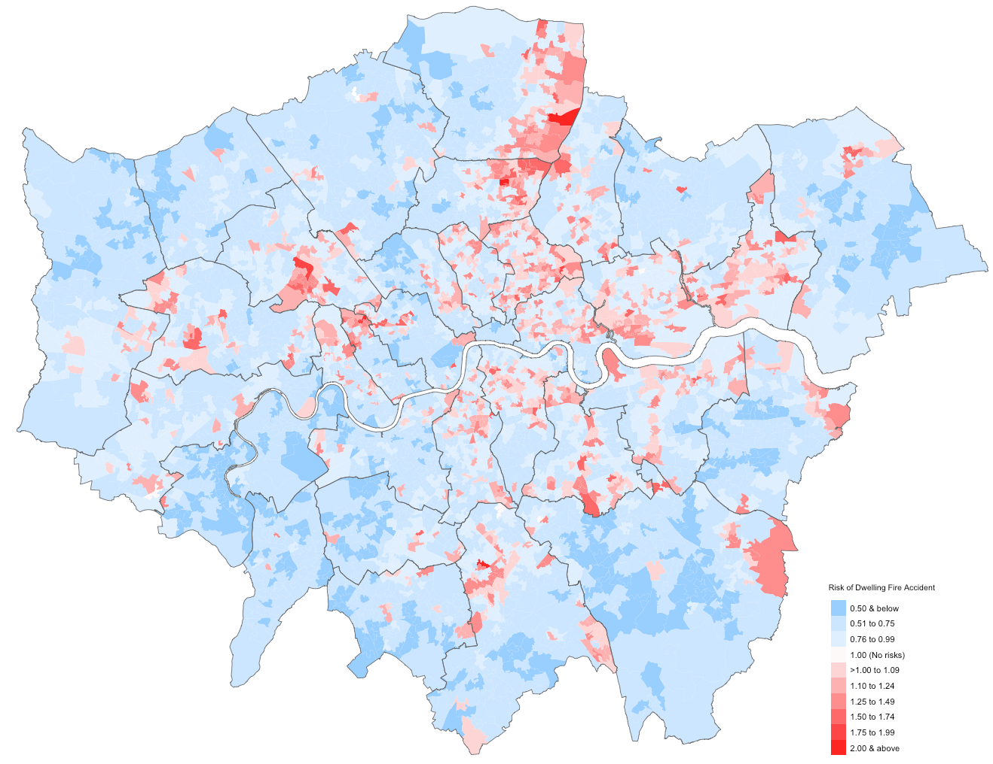
Department of Geography
Bayesian Methodology
We have introduce the basics of Bayesian inference
We learnt how to implement the following for evidence-based research:
GLMs
GAMs
Hierarchical models
Spatial iCAR models
We have learned how to use Stan with RStudio for Bayesian inference
30

Slide 31
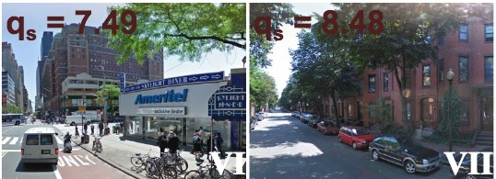
Machine Learning and GeoAI
We have introduce the subfield of Machine Learning for complex image classification in geography.
We have learnt how to implement the following approaches:
Deep Learning Methods
Convolutional Neural Networks
GeoAI
We have learned how to use PyTorch & Python for implementing these complex machine learning algorithms
Image Classification
Object Detection
31
Image source: https://developer.nvidia.com/blog/parallelforall/wp-content/uploads/2016/08/Figure2-624x193.png
Building Footprint Detection
Notes:
Research in social&geographic data science focused mainly on supervised methods. The question is what types of knowledge can be learn from unsupervised methods?

Slide 32
GEOG0125: Course Evaluation & Student Feedback (Weeks 1-3 and 7-9)
https://forms.gle/3AHiH4Q2L7NmXZCe9
Dear Students,
As part of the Continuous Module Dialogue, we are conducting this survey to gauge the levels of student satisfaction with the learning experience in module GEOG0125: Advanced Topics in Social & Geographic Data Science. We would like to receive your feedback, which would be greatly appreciated. This will help us make improvements to the course. The survey should only take up to 5 minutes, and your responses are completely anonymous.
Thank you,
Anwar and Stephen.
32

Slide 33
GEOG0125: Course Evaluation & Student Feedback (Week 4 to 6)
https://forms.gle/rddFzY8UABaZhyDK9
Dear Students,
As part of the Continuous Module Dialogue, we are conducting this survey to gauge the levels of student satisfaction with the learning experience in module GEOG0125: Advanced Topics in Social & Geographic Data Science. We would like to receive your feedback, which would be greatly appreciated. This will help us make improvements to the course. The survey should only take up to 5 minutes, and your responses are completely anonymous.
Thank you,
Anwar and Stephen.
33

Slide 34
Any questions?
34

Slide 35
Revision and Assessment
35

Slide 36
GEOG0125 Assessment
Be concise, accurate and purposeful in what you write. Justify all your decisions, either with your data analysis or literature including model choice, parameter choice.
A excellent introduction contains the following: rationale and justification for pursuing a research question and scientific reason for selecting a particular study area.
Tables and Figures should be clear (readable), purposeful, captioned, and linked to the data report.
The two parts of the assessment should be seen as two extended abstracts with its own introduction, method, results, conclusion.
For the Bayesian analysis subsection, select a dataset that is of areal units and apply a Bayesian Spatial risk model. Perform a risk assessment and generate mapped output for the relative risks, significance (95% credibility limits) and exceedance probabilities.
Provide an overall interpretation of the global and area-specific estimates from the Bayesian model.
For the Machine learning subsection, select a dataset and the type of problem you want to answer (e.g., image classification). Remember to explain the model you will test and the pipeline you will go through. Always report the “out of sample test” set results (e.g., in a table) as generalisation is key in ML.
Look at the coursework assessment criteria and please do not include actual “code” in the report.
Have fun!!!
36
Image source: https://developer.nvidia.com/blog/parallelforall/wp-content/uploads/2016/08/Figure2-624x193.png
Building Footprint Detection

Slide 37
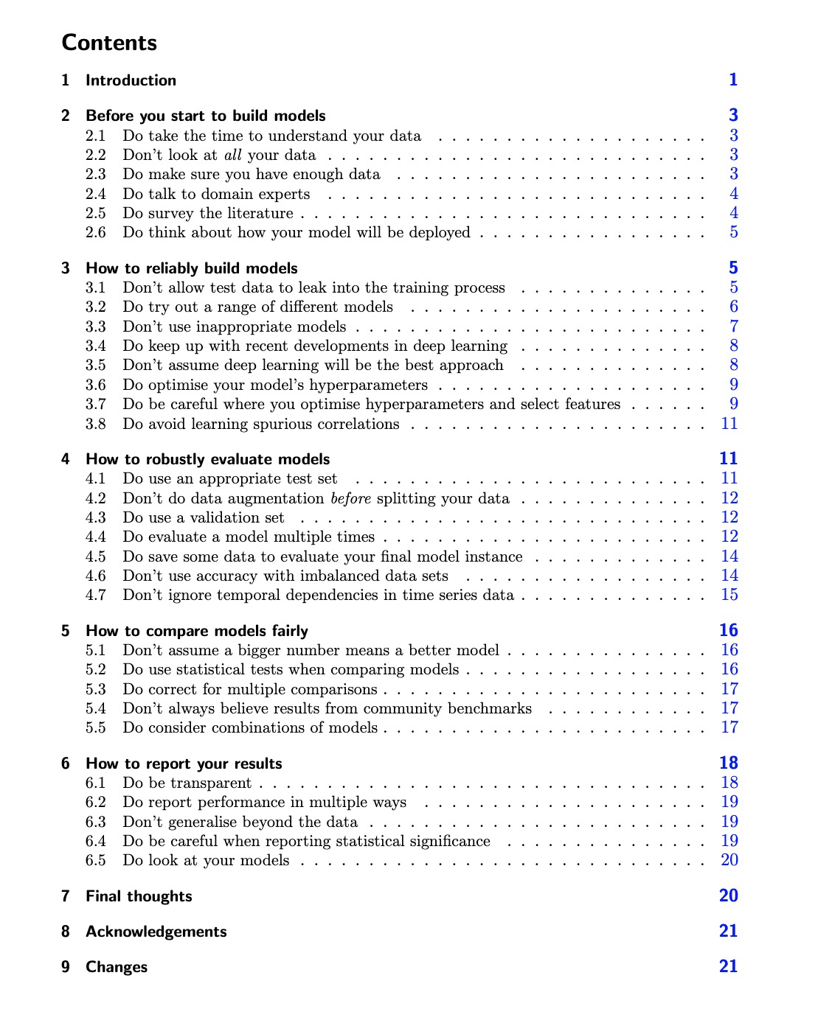
Machine learning workflows and pitfalls
Preprocess and Explore to visualize, describe and understand data, standardise to stabilize training and make features comparable.
Resample dataset into a train, val and test set. The aim of machine learning model is to optimize out-of-sample accuracy.
Train multiple models with different methods and features. A common research problem is to test a different method or feature.
Fit models with training data, tune parameters with validation data and evaluate on test data. Check for overfitting.
Sanity check the outputs of the final model
Report with a table on the different models and predictive plots.
What do the result mean? What are its implications? What are the limitations?
Lones, M. A. (2021). How to avoid machine learning pitfalls: a guide for academic researchers. arXiv preprint arXiv:2108.02497. https://arxiv.org/pdf/2108.02497.pdf
37

Slide 38

“You’re gonna carry that weight…”
38
Notes:
You’re gonna to carry that weight

